Slide 1
Computer Vision

Slide 2

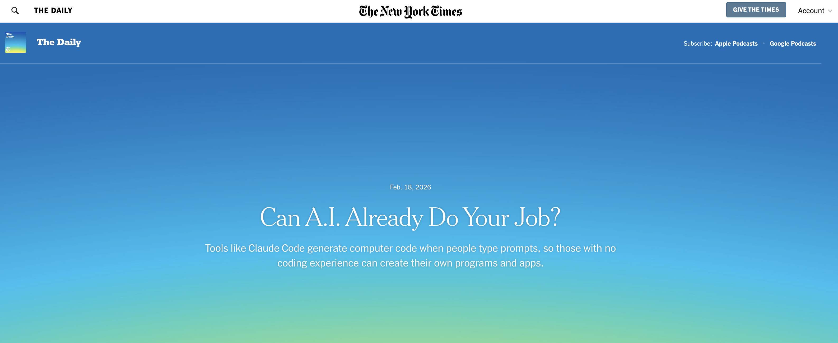
What’s In the News?

Slide 3
This Week
Convolutional Neural Networks (CNNs)
What CNNs try to accomplish
What is a convolution?
Padding, strides, filters
What is pooling?
Max, min, avg pooling.
Other Stuff
CNN specific techniques to avoid overfitting (data augmentation).
Extracting feature representations from your trained model.
Adapting pre-trained models (transfer learning).

Slide 4
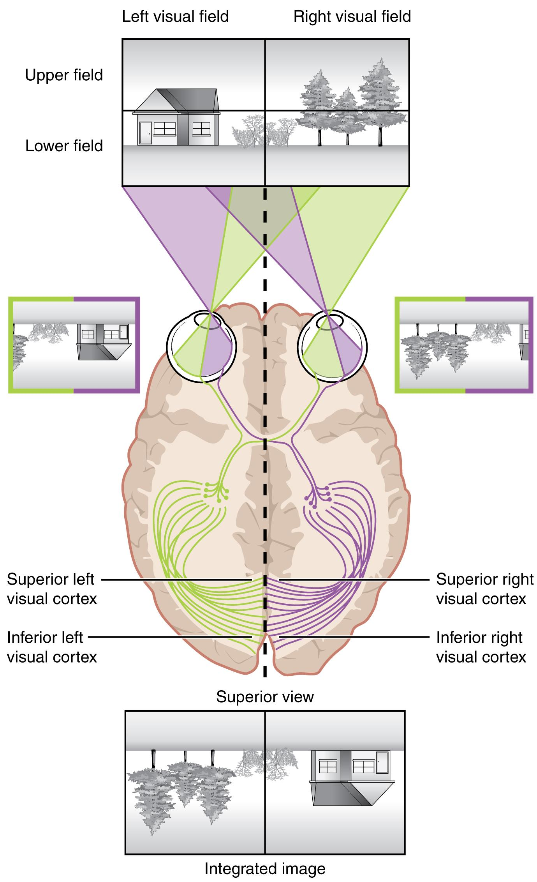
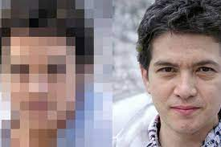
Inspiration for Convnets
Our Visual System
Human eye is basically a 576-megapixel video camera.
For comparison, the Pixel 6 camera is 50-megapixels.
The human field of vision is not a square; something like a video camera that records individual image frames comprised of 24,000 x 24,000 pixels.

Slide 6
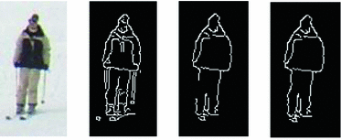
We Don’t Detect Features ‘Manually’
How Does Your Visual System Work?
We think that your brain processes individual visual receptors in groups, identifies combinations of inputs in proximity to one another that imply something like an edge (edge detection), combines that with color and so on. These low-level features are then processed together to arrive at higher level objects (e.g., a nose, a mouth, an eye).
Those higher-level features are then processed together to yield a face (perhaps someone we know or do not know). Hence why you might have a hard time recognizing someone who has a new haircut, or who is wearing a facemask!

Slide 7
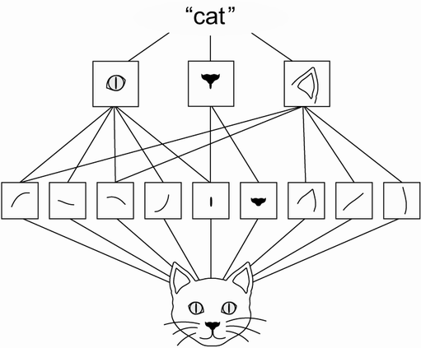
Feature Detection / Aggregation

Slide 9
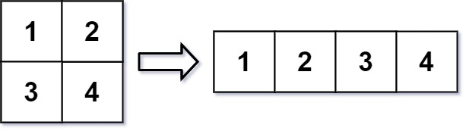
Review: Why are Fully Connected Dense Layers (MLPs) Not Good for This?

Slide 10
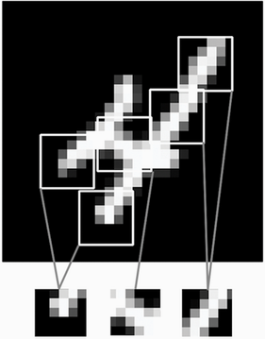
We Need to Preserve Spatial Arrangements
Hone-in On Sub-sections of the Image
So, if we have a 28x28 image, we might separately consider 3x3 pixel subsection of that image. Each subsection (they can be overlapping) is represented by its own node in the first hidden layer.
That local input matrix (subfield) is considered in tandem with a ‘filter’ a matrix of weights. A filter might be something like

Slide 11
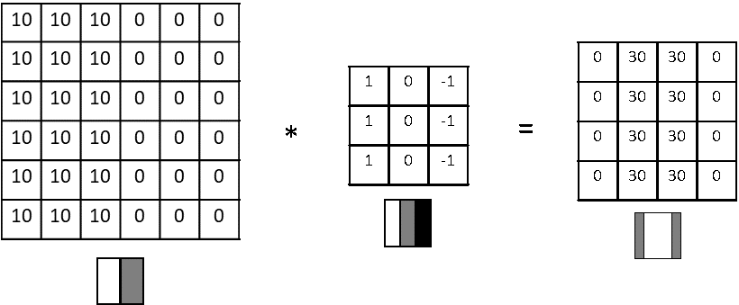
The Convolution Operation
Consider in Matrix Representation
We have the raw image data (a.k.a. input feature map), the filter, and the result of passing our filter over our image (a.k.a. output feature map). We will have one output feature map for a given image, per filter (each filter is intended to detect a different type of feature).
The filter elements are just weights for the Conv layer; we learn the filter values as part of the backpropagation process. So, the CNN will figure out what features to look for to predict the label (probably what a baby does when its first board and first learning how to process visual information).

Slide 12
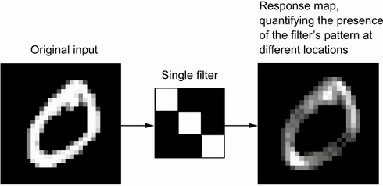
The Convolution Operation
Consider in Matrix Representation
We have the raw image data (a.k.a. input feature map), the filter, and the result of passing our filter over our image (a.k.a. output feature map). We will have one output feature map for a given image, per filter (each filter is intended to detect a different type of feature).
The filter elements are just weights for the Conv layer; we learn the filter values as part of the backpropagation process. So, the CNN will figure out what features to look for to predict the label (probably what a baby does when its first board and first learning how to process visual information).

Slide 13
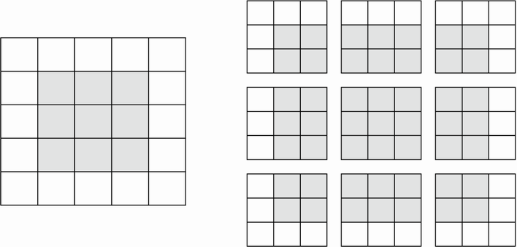
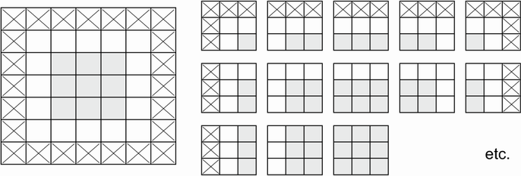
Padding
Padding
To prevent the transformation from down-sampling (reducing the size of the matrix during convolution to output), we can pad the edges of the image with 0’s.

Slide 15
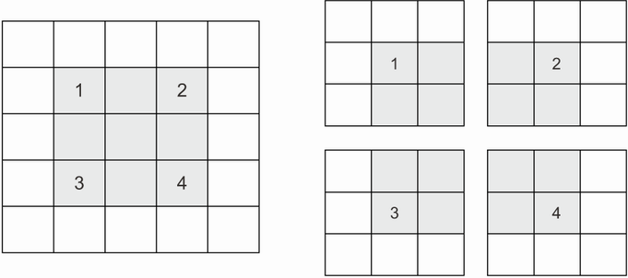
Strides
Strides
Often, we will pass the filter over every pixel cell, but we don’t have to; we might pass over every other cell. This is what strides refers to (skipping).
Notes:
E.g., one for vertical lines, one for horizontal lines, one for diagonal lines, etc. The output feature maps might then feed into another convolutional layer, with its own filters, (perhaps representing nose, eye, mouth), and so on.

Slide 16
Padding and Strides
Padding
To prevent the transformation from down-sampling (reducing the size of the matrix during convolution to output), we can pad the edges of the image with 0’s.
Strides
Often, we will pass the filter over every pixel cell, but we don’t have to; we might pass over every other cell.
This is what strides refers to (skipping).
Notes:
E.g., one for vertical lines, one for horizontal lines, one for diagonal lines, etc. The output feature maps might then feed into another convolutional layer, with its own filters, (perhaps representing nose, eye, mouth), and so on.

Slide 17
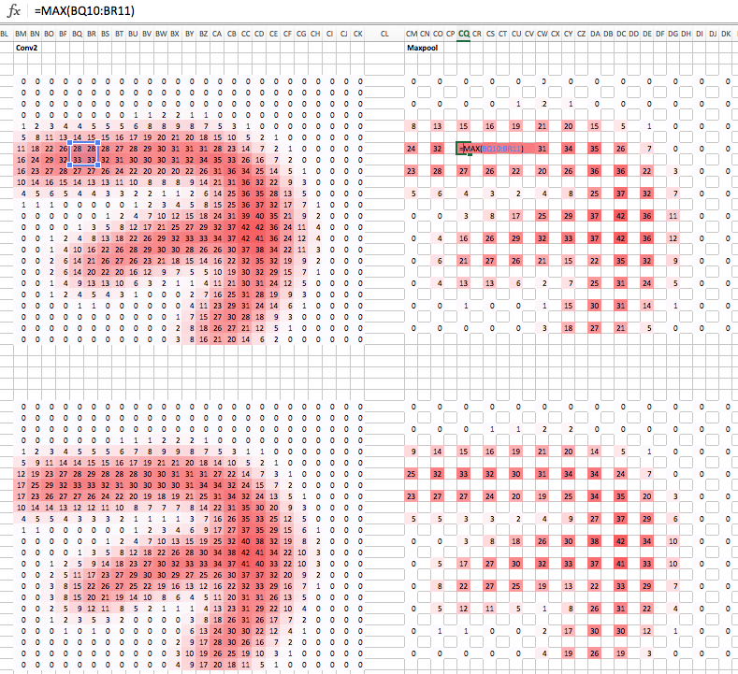
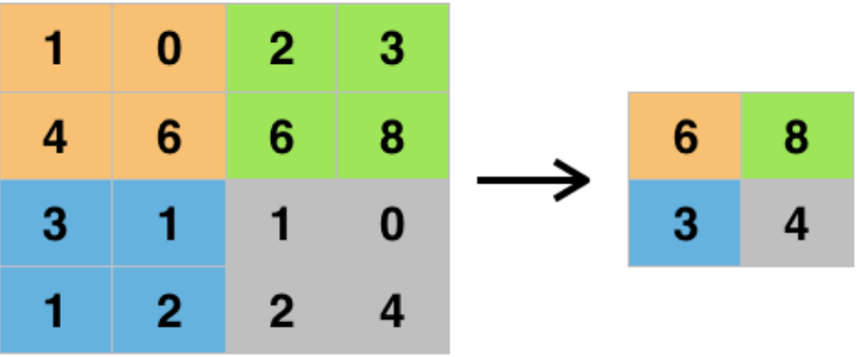
What is Pooling?
Down-sampling Detected Features
The idea is to compress the resulting data down into a coarser representation, to reduce model complexity, and to also force attention toward a broader section of the original image (helps reduce overfitting).
Forcing Attention to Larger Blocks of the Original Image
Because we typically use stride = pool width, the pooling output is aggregating over segments of the input.
Notes:
E.g., one for vertical lines, one for horizontal lines, one for diagonal lines, etc. The output feature maps might then feed into another convolutional layer, with its own filters, (perhaps representing nose, eye, mouth), and so on.

Slide 18
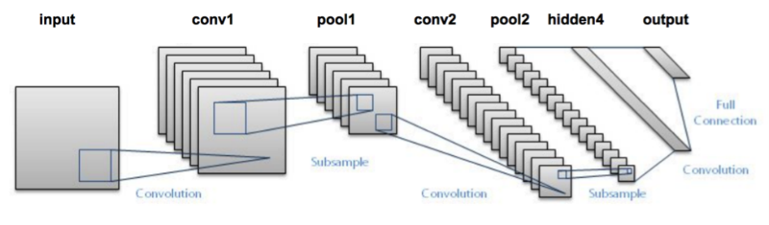
A Basic Image Labeling Architecture
Convolution Layers Apply (Multiple) Filters
Each filter is a matrix of trainable weights.
As you move through the network, the number of features typically rises exponentially.
More filters as you move along means it allows more permutations / combinations
Progressively Smaller Filter Maps
Smaller filter map arises from the pooling steps, which means that each element of the final map distills features (high level features, derived from low level features, derived from raw pixels) derived from a larger segment of the original picture.
Notes:
E.g., one for vertical lines, one for horizontal lines, one for diagonal lines, etc. The output feature maps might then feed into another convolutional layer, with its own filters, (perhaps representing nose, eye, mouth), and so on.

Slide 19
Object Recognition Tasks

Slide 23
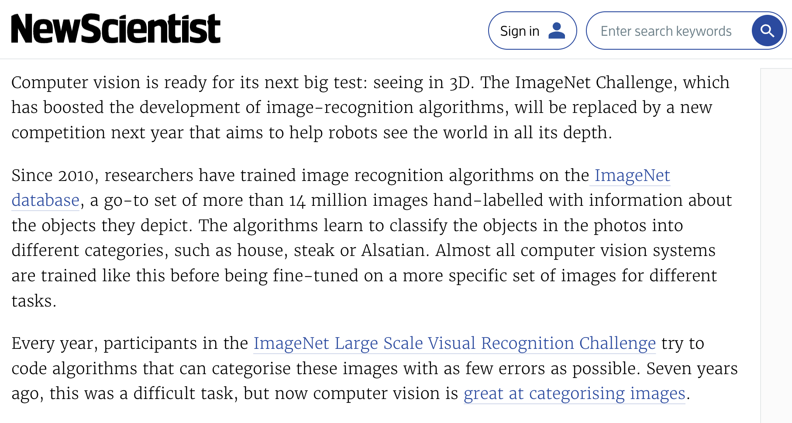
ImageNet Challenge Was Ended After 2017
Notes:
Computer vision models got so good at this task that it became the new MNIST problem. It’s basically solved. Now people are focused on 3D image tasks, and there are various new challenges.

Slide 24
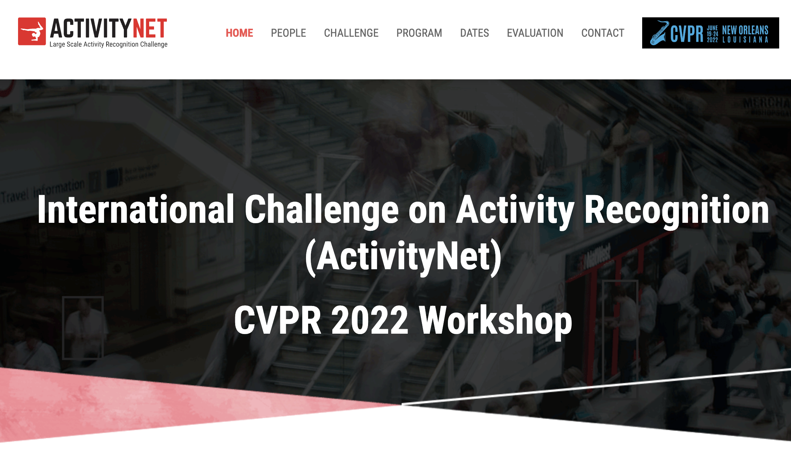
Shifted Focus to Harder Problems

Slide 25
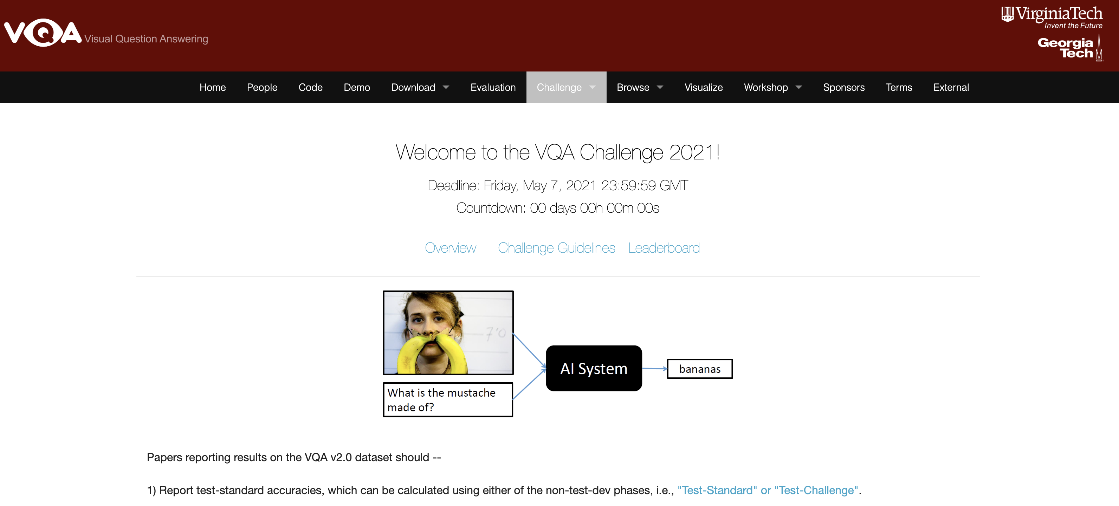
Shifted Focus to Harder Problems

Slide 27
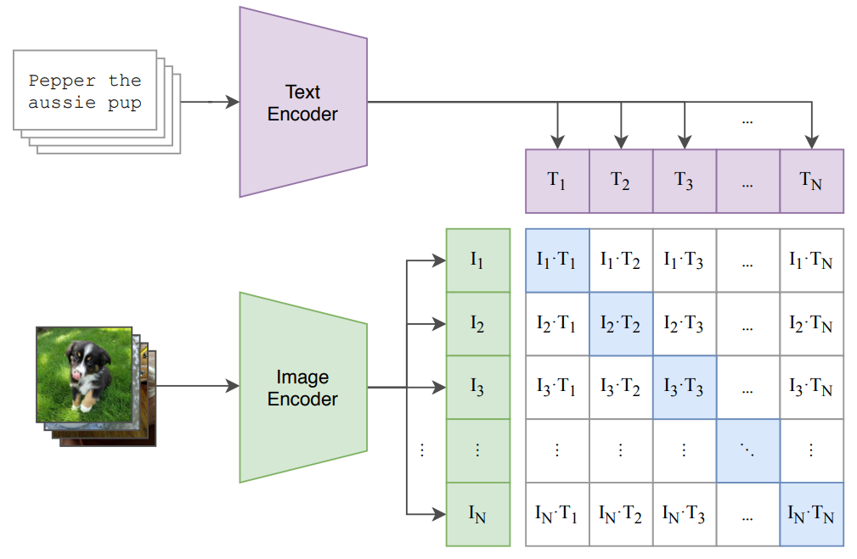
Contrastive Language-Image Pre-training (CLIP)
Notes:
Each observation is a ‘set’ of images and a set of captions. We train the model to predict which image goes with which caption, but we don’t actually care about the predictions. It’s a throw-away aspect of training. The resulting model learns highly informative (much more informative than before) representations of images in a vector space, a vector space that is also shared by text embeddings. We can map text to images, and images to text, quite accurately.

Slide 28
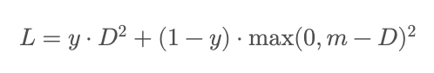
Contrastive Loss
The goal here is *not* prediction. The goal is to train a model that can encode inputs into numeric vector representations in a shared embedding space, such that ‘similar’ vectors are conceptually related, and ‘dissimilar’ vectors are conceptually unrelated.
We have a special loss function that we minimize for this purpose, where it is once again a 2-part loss, depending on whether the ‘pair’ of inputs is positive (related) or negative (unrelated).

Slide 29
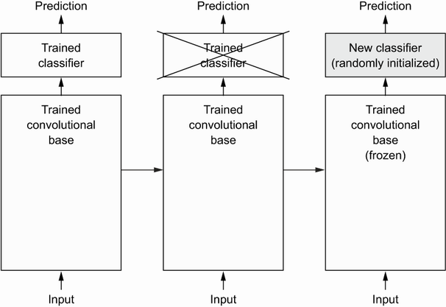
Pre-Trained Models: Feature Extraction
Take the convolutional base layers from someone else’s model, then…
Two Options
Feed Data Through Model Base: feed your images through convolutional base, take the outputs, and then use those as your predictors, feeding them into a network of dense layers.
Freeze Model Base and Include in Network: Take the convolutional base layers from someone else’s model and freeze them (make parameters non-trainable), then stack your (trainable) Dense layers onto the end. This lets you add data-augmentation to the front of the model.

Slide 30
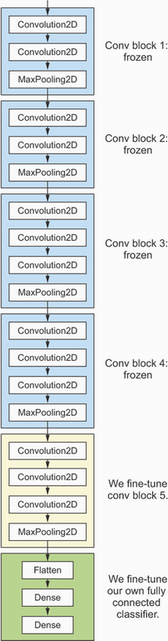
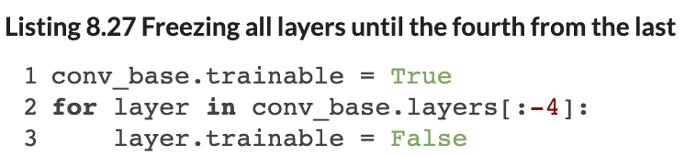
Pre-Trained Models: Fine Tuning
Take the convolutional base layers from someone else’s model, then…
Freeze Only the First Several Layers
Allow your network to modify / update the last few convolutional base layers as part of training, along with your own Dense layers…
Iterate over the layers in the network and set the last few to be trainable.
Notes:
E.g., one for vertical lines, one for horizontal lines, one for diagonal lines, etc. The output feature maps might then feed into another convolutional layer, with its own filters, (perhaps representing nose, eye, mouth), and so on.

Slide 31
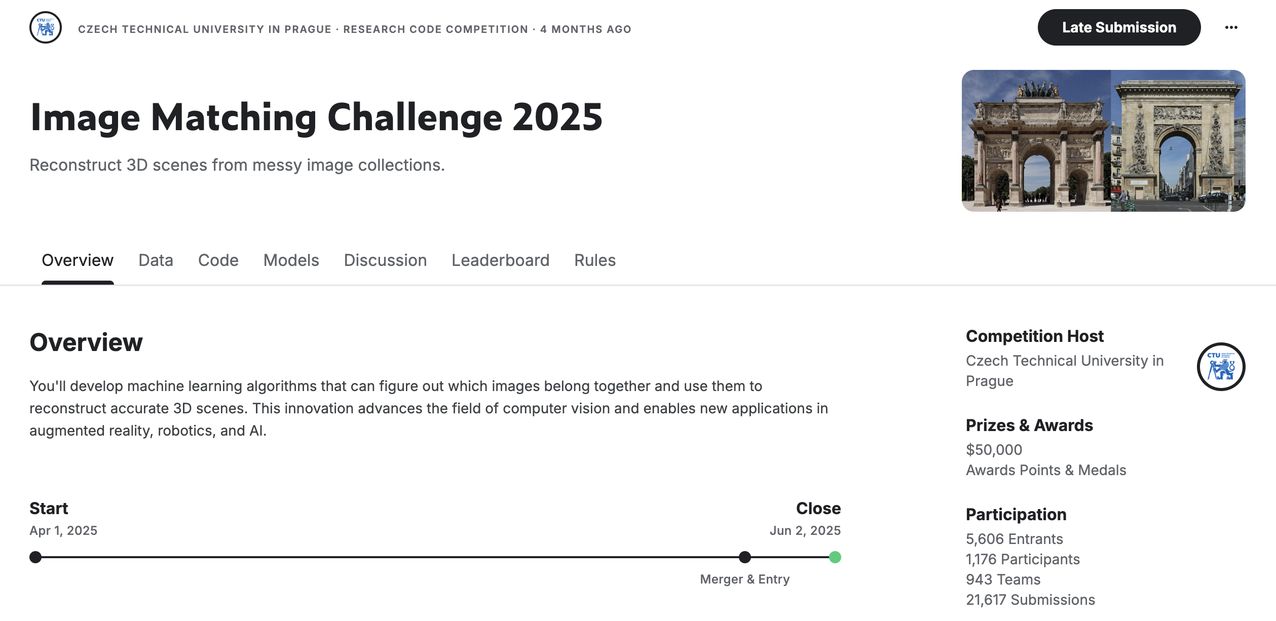
What Are People Tackling Now? 3D Scene Reconstruction

Slide 32
Self-Evaluation & Peer Call-outs

Slide 33
Questions?

